Slide 1
Definitions
Variable – The characteristic that is being measured or observed. The variable will generally be labeled on the X-axis.
Quantitative Variable. Data consisting of pure numerical measurements.
Qualitative Variable. Data consisting of attributes or labels.
Notes:
Qualitative Data.
Examples:
Ford Explorer; Honda Civic.
Red, Green, Yellow.
Heads, Tails
Defective part, Nondefective part.
Quantitative Data.
Examples:
$21,412
402

Slide 2
Probability Distributions
A Probability Distribution is the listing of all possible outcomes of an experiment and the corresponding probability. It gives the entire range of values that can occur.
A Discrete Probability Distribution can assume only certain countable outcomes, such as {0,1,2,3, …} .
A Continuous Probability Distribution can assume an infinite number of values within a given range.

Slide 3
Probability
Probability (Chance). The likelihood that an event will occur. All probabilities always fall between 0 and 1, and are usually expressed as percentages.
Notes:
See

Slide 4
Types of Probability
Classical. (Also referred to as Theoretical). The number of outcomes in the sample space is known, and the probability of each outcome is also known.
Empirical. (Also referred to as Experimental, Statistical or Relative Frequency). The frequency of outcomes is measured by experimenting.
Subjective. You estimate the probability by making an “educated guess”, or by using your intuition.

Slide 5
Definitions
Probability (Chance). The likelihood that an event will occur. All probabilities always fall between 0 and 1, and are usually expressed as percentages.
Experiment. Controlled testing. Any process that generates well defined outcomes. For example, the experiment of flipping a coin has 2 defined outcomes, heads or tails. S = {H, T}.
Random Variable. An experimental outcome that generates exactly one numerical value.
Event. The outcome of an experiment. For example, The outcome of rolling an even number on a die is A = {2, 4, 6}, and P(A) = 1/2. The outcome of rolling a five is A = {5}, and P(A) = 1/6 (or P(5)=1/6).
Sample Space. All of the possible outcomes (events) of an experiment. For example, the outcomes possible when rolling a single die are S = {1, 2, 3, 4, 5, 6}. The outcomes possible when flipping a coin are S = {H, T}. The sum of the probabilities of all possible outcomes is always equal to 1.

Slide 6
The Complement Rule
The complement rule is used to determine the probability of an event occurring by subtracting the probability of the event not occurring from 1.
If P(A) is the probability of event A and P(A^{C}) is the complement of A,
P(A) + P(A^{C}) = 1 or P(A) = 1 - P(A^{C}).

Slide 7
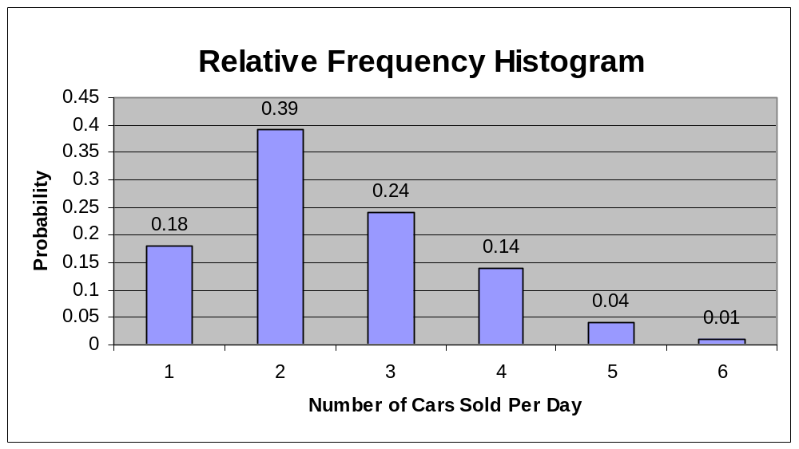
0 1 2 3 4 5

Slide 8


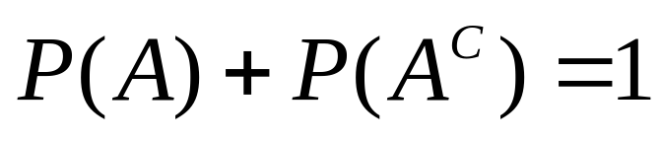
Venn Diagrams
Event A
Complement of A
Total Sample Space (S). P(S) = 1
Example: Suppose you roll a die and the outcome you want to observe is that of rolling a 4. Therefore, A = {4}, and ~A = {1, 2, 3, 5, 6}.

Slide 9
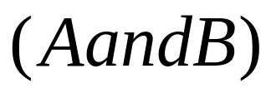








Intersection of Events A and B
The intersection of events A and B is the event containing the sample points belonging to both A and B.
Example: Suppose you roll a die and the outcome you want to observe is that of rolling a number greater than 3 and rolling an odd number. Therefore, A = {4,5,6} and B = {1, 3, 5}. The intersection is rolling a 5.

Slide 10


Union of Events A and B
(the addition law)
The union of events A and B is the event containing the points belonging to A or B, or both.
Example: Suppose you roll a die and the outcome you want to observe is that of rolling a number greater than 3 or rolling an odd number. Therefore, A = {4,5,6} and B = {1, 3, 5}. The union is rolling a 1, 3, 4, 5, or 6. Therefore, P(A+B) = 1/6+1/6+1/6+1/6+1/6 = 5/6.
Subtract the double-counted outcome.
(See P.219 for notation.)
Notes:
This is a compound event - it contains more than one possible outcome for the experiment. A compound event is therefore made up of more than one simple event.
Example:
For married couples, 30% of husbands and 20% of wives watch TV on Friday nights after work. Of this group, 12% of couples watch TV together. Therefore, the probability that at least one member of the marriage is watching TV on Friday night is:
P(HorW) = P(H) + P(W) - P(HW) = .30 + .20 - .12 = .38.
Events like this that share an intersection are not mutually exclusive.
Mutually Exclusive. Two events A and B are mutually exclusive if A and B can not occur at the same time.

Slide 11


Mutually Exclusive Events
Experiment
Two or more events are mutually exclusive if the events have no points (or outcomes) in common.
In other words, it’s impossible for both events to occur at the same time. Each outcome is unique and has nothing in common with the other.
Example: Suppose you roll a die and the outcome you want to observe is that of rolling either an even number or an odd number. Therefore, A = {2,4,6} and B = (1,3,5}, and the two events have absolutely nothing in common.
Notes:
Events that share a union can be either mutually exclusive or not mutually exclusive.
Example:
For married couples, 30% of husbands and 20% of wives watch TV on Friday nights after work. However, in this group the spouses have very different tastes from one another and don’t like the TV programs that each other watches. Therefore, 0% of couples watch TV together. The probability that at one membr of the marriage is watching TV on Friday night is now:
P(HorW) = P(H) + P(W) - P(HW) = .30 + .20 - .0 = .50

Slide 12

Independent Events
Two events are independent if the occurrence of one event does not affect the occurrence of another event.
Therefore, the probability of event A occurring given that event B has already occurred equals the probability of event A:
The independent occurrence of event B does not change the occurrence of event A.
Notes:
Example: The probability of flipping a head given you’ve just flipped 5 heads in a row.

Slide 13

Dependent Events
Two events are dependent if the probability of one event changes given that another event has occurred.
Notes:
Example: The probability of picking a King, given that you have just picked a queen.

Slide 14
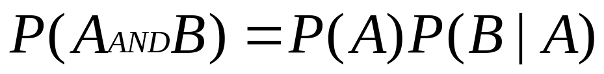
Multiplication Law
(joint probability)
The multiplication law is derived from the definition of conditional probability.
Example: Suppose you choose two cards from a deck of 52 cards. What is the probability of selecting a king [P(K)] from the deck, not replacing it, and then immediately selecting a queen P[(Q|K)].
Answer: Selecting a king changes the probability of selecting the very next card. P(K) = 4/52, after which the P(Q) then becomes 4/51.
Because the first card is not replaced, the events are dependent.
P(KandQ) = P(K)P(Q|K) = (4/52)(4/51) = .006

Slide 15
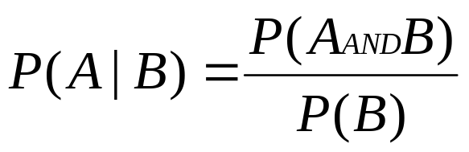
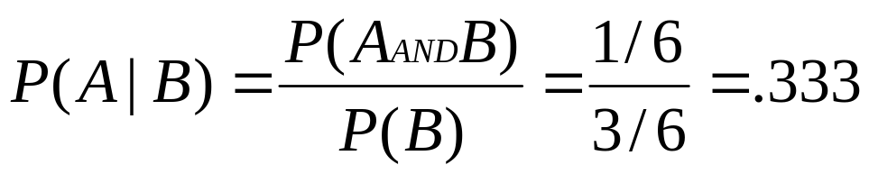
Conditional Probability
A conditional probability is the probability of an event occurring given that another event has already occurred. The notation reads: P(A|B) = Probability of A given that B has already occurred.
Example: Suppose that event A is rolling a die = 5, or A = {5}. Suppose event B is rolling an odd number, or B = {1,3,5}. So, P(A|B) is the probability that the outcome is greater than 3 given that you have rolled an odd number. The probability of rolling and odd number is P(B) = 1/3. The intersection of A and B is 5, and P(5) = 1/6.
Notes:
We’ve already rolled an odd number, so its already a “given” that the number rolled was either a 1, 3, or 5.

Slide 16
Discrete Probability Distributions
Expected Value
Expected Value is the theoretical long run average outcome of an experiment or process.

Slide 17
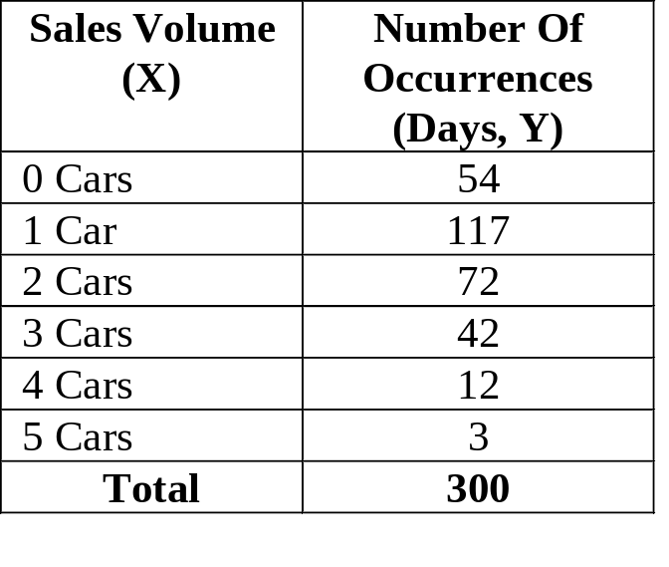
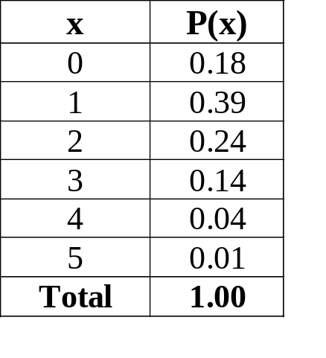
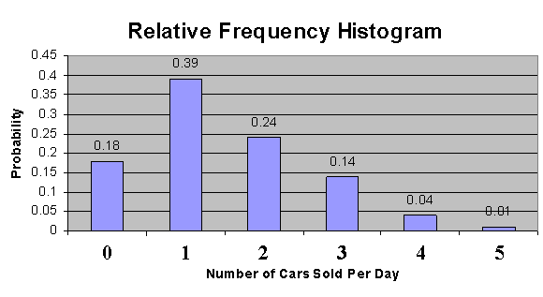

Probability Distribution For A Discrete Random Variable
Discrete Probability Distribution
E(x) = 0(.18) + 1(.39) + 2(.24) + 3(.14) + 4(.04) + 5(.01) = 1.5
Notes:
The expected value of a random variable is the mean, or average value. That is, for experiments that can be repeated numerous times, the expected value can be interpreted as the “long-run” average value for the random variable. So, the expected value is actually the “theoretical average” of the experiment and is often not a possible outcome. For example, in this case the expected value = 1.5, and it’s not possible to sell 1.5 cars in a day since the number of cars sold is a discrete random variable.
E(x) = 0*.18 + 1*.39 + 2*.24 + 3*.14 + 4*.04 + 5*.01 = 1.5

Slide 18
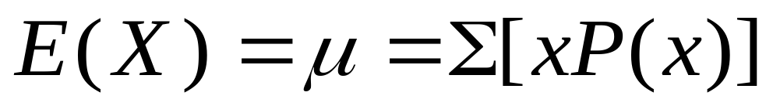
The Mean of a Discrete Probability Distribution
The mean is computed by the formula:
The Expected Value of X, or E(X) is the theoretical long run average outcome of X.

Slide 19
Example
Consider a random experiment in which 3 coins are tossed in each trial. Let x be the number of heads in each trial. Let H represent the outcome of a head and T the outcome of a tail.

Slide 20
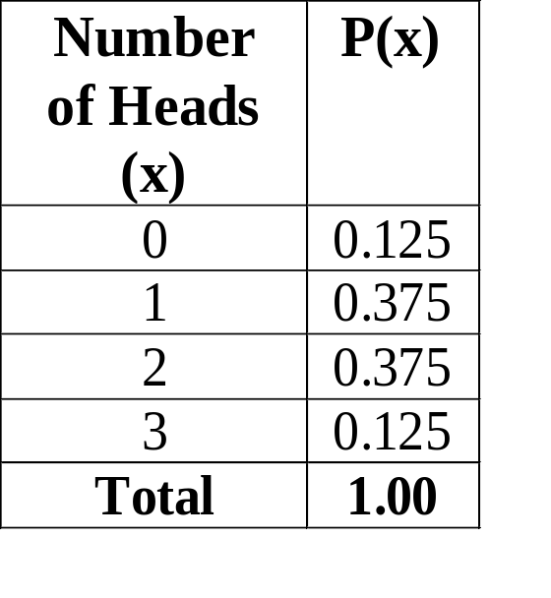

EXAMPLE 1 continued
The possible values of x (number of heads) are 0,1,2,3.
TTT
TTH
THT
THH
HTT
HTH
HHT
HHH
000
001
010
011
100
101
110
111
E(x) = 0(.125) + 1(.375) + 2(.375) + 3(.125) = 1.5

Slide 21
Principles of Counting
We count the total number of events in the sample space.
Notes:
See

Slide 22
When counting the total number of possible events that can occur, we can use one or more of these methods.
Multiplication Rule
Factorials
Permutations (nPr)
Combinations (nCr)

Slide 23
Multiplication Formula
Principles of Counting
The Multiplication Formula indicates that if there are m ways of doing one thing and n ways of doing something else, there are m x n ways of doing both (usually in sequence).
Example: Dr. Smith has 10 shirts and 8 ties. How many shirt and tie outfits does he have?
(10)(8) = 80
Notes:
This usually refers to things done in sequence.

Slide 24
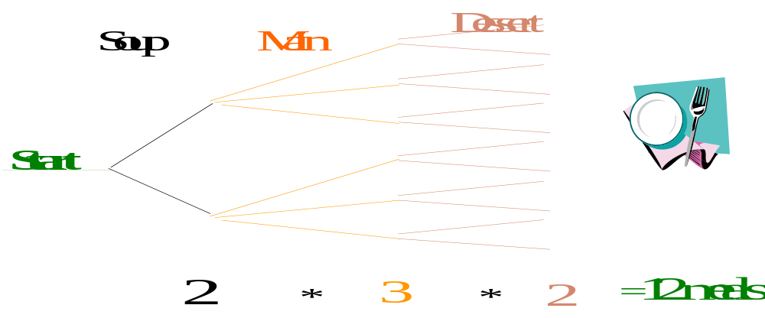
If one event can occur m ways and a second event can occur n ways, the number of ways the two events can occur in
sequence is m*n. This rule can be extended for any number
of events occurring in a sequence.
If a meal consists of 2 choices of soup, 3 main dishes and 2 desserts,
how many different meals can be selected?
Notes:
The probability of ordering a particular soup and particular main dish and a particular desert is 1/12 or 0.083

Slide 25
The Multiplication Formula can be extended to more than two events:
Example: Dr. Smith has 10 shirts, 8 ties, and 5 pants. How many shirt, tie, and pants outfits does he have?
(10)(8)(5) = 400
Example: Sears offers three models of stereo receivers, two cassette decks, four speaker pairs, and three CD units. Sold together, these four units form a “Sound System”. How many different “Sound Systems” can Sears offer?
(3)(2)(4)(3) = 72 Different Systems

Slide 26
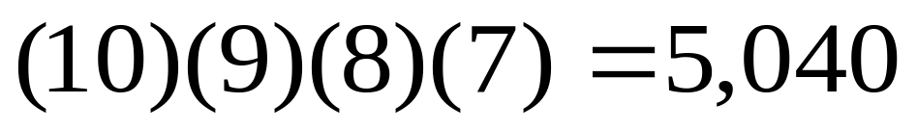
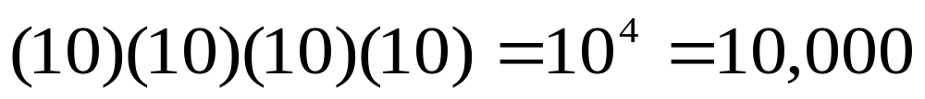
EXAMPLE: Suppose an electronic lock has a keypad with 10 digits - 0 through 9 - and requires a 4 digit code. How many different combinations (security codes) are possible if no digit can be repeated.
EXAMPLE: Suppose an electronic lock has a keypad with 10 digits - 0 through 9 - and requires a 4 digit code. How many different combinations (codes) are possible if any combination of digits can be used and repeated?
(0000 to 9999)

Slide 27
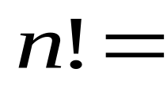
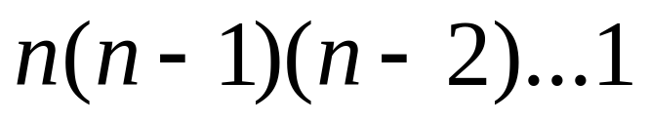
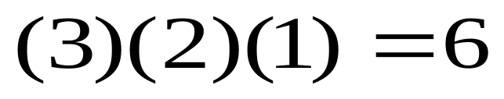
Factorials
Suppose you want to arrange n objects in order.
There are n choices for 1st place, n-1 choices for second place, and n-2 choices for third place.
So the number of ways of arranging n objects is:
This is called n factorial and written as n!
So 3! would be written as:
Notes:
Use presidential race example.
Suppose there was a foot race with only 3 people in the race. The number of ways that the contestants could finish would be:
A = Albert
B = Brad
C = Charles
ABC
ACB
BAC
BCA
CAB
CBA

Slide 28
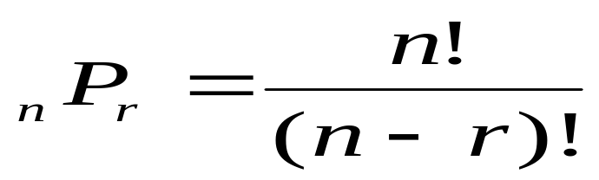
Permutations
A permutation is an ordered arrangement of r objects
The number of permutations for n objects is n!
n! = n (n - 1) (n -2)…..3 * 2 * 1
The number of permutations of n objects
taken r at a time (where r ≤ n) is:
The number of ordered ways we can arrange a group of r objects from a starting group of n objects.
Notes:
In counting permutations, order is important.

Slide 29
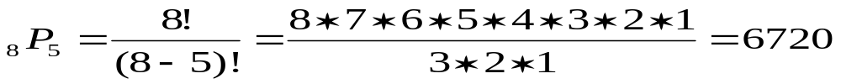
Permutations
A permutation is an ordered arrangement of r objects
The number of permutations for n objects is n!
n! = n (n - 1) (n -2)…..3 * 2 * 1
The number of permutations of n objects
taken r at a time (where r ≤ n) is:
☑ You are required to read 5 books from a list of 8. In how many
different ordered ways can you read the 5 books?
There are 6,720 different ordered ways of reading 5 out of 8 books.
Notes:
In counting permutations, order is important.

Slide 30
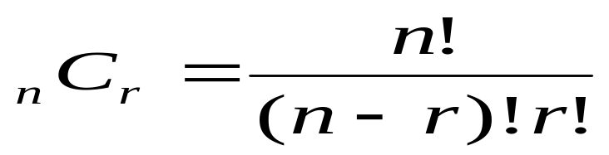
Combinations
A Combination is the number of ways to choose r objects from a group of n objects without regard to order.
You are required to read 5 books from a list of 8. In how many
different ways can you choose the books if order does not matter.
There are 56 ways of reading 5 out of the eight books, in no particular order.
Notes:
In counting combinations, order does not matter. An object is either selected or it is not. Therefore, permutations will always be greater than or equal to combinations.
The vast majority of scientific calculators have P and C as built in functions.

Slide 31
When counting the total number of possible events that can occur, we can use one or more of these methods.
Multiplication Rule (m x n)
Factorials [n! = n(n-1)(n-2)…1]
Permutations (nPr) Order IS important within r
Combinations (nCr) Order is not important within r

Slide 32
When using Permutations or Combinations we want to know how many groups of size r are possible from a sample of size n ?
Combinations nCr (Order within the group of r is NOT important)
Permutations nPr (Order within the group of r IS important)

Slide 33
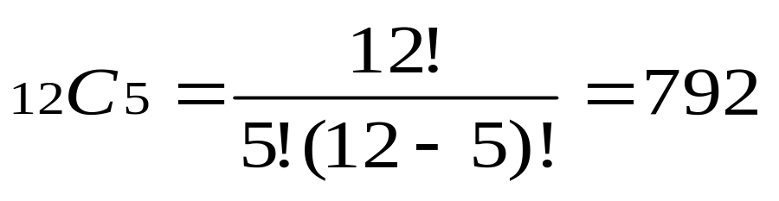
EXAMPLE
There are 12 players on a basketball team. The coach must pick five players among the twelve for the starting lineup. How many different groups (different teams on the floor) are possible?

